Slide 1

SOCIAL MEDIA DATABASE

Slide 2
INTRODUCTION
The Social Media Database is designed to manage user interactions and content on a social media platform. It includes tables for users, posts, comments, likes, hashtags, and associations between them. This database structure facilitates tracking user activities, managing content, and generating insights into user engagement and trends. It supports a range of queries and reports to analyze and optimize platform performance and user experience.

Slide 3
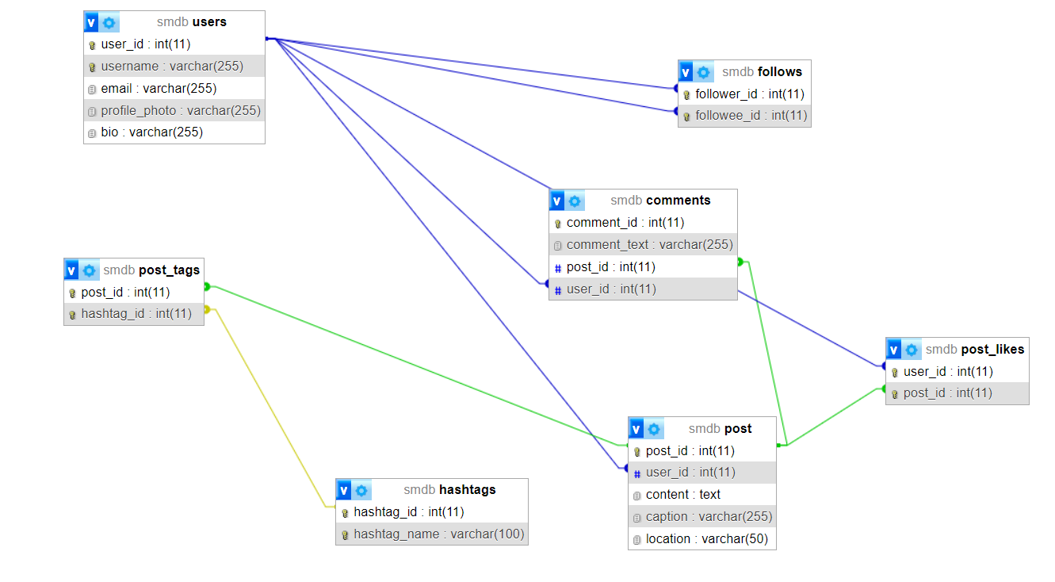
ER DIAGRAM

Slide 4
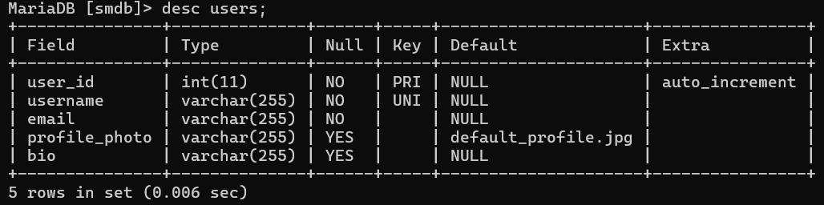
TABLES
USERS
Syntax:
CREATE TABLE users (
user_id INT AUTO_INCREMENT PRIMARY KEY,
username VARCHAR(255) UNIQUE NOT NULL,
email VARCHAR(255) NOT NULL,
profile_photo VARCHAR(255) DEFAULT 'default_profile.jpg',
bio VARCHAR(255)
);

Slide 5
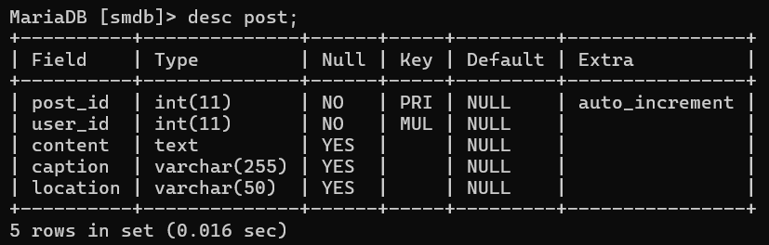
POST
Syntax:
CREATE TABLE post (
post_id INT AUTO_INCREMENT PRIMARY KEY,
user_id INT NOT NULL,
content TEXT,
caption VARCHAR(255),
location VARCHAR(50),
FOREIGN KEY (user_id) REFERENCES users(user_id)
);

Slide 6
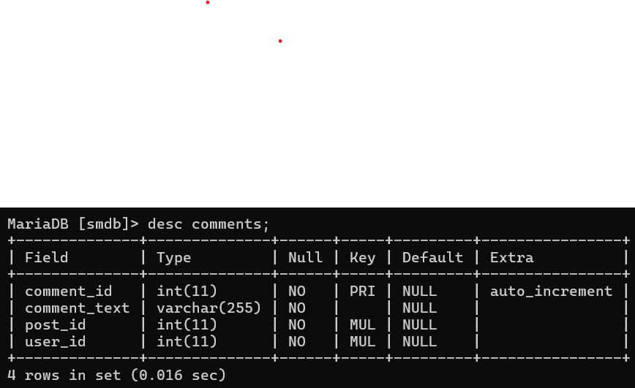
COMMENTS
Syntax:
CREATE TABLE comments (
comment_id INT AUTO_INCREMENT PRIMARY KEY,
comment_text VARCHAR(255) NOT NULL,
post_id INT NOT NULL,
user_id INT NOT NULL,
FOREIGN KEY (post_id) REFERENCES post(post_id),
FOREIGN KEY (user_id) REFERENCES users(user_id) );

Slide 7
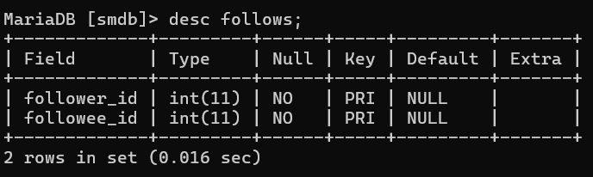
FOLLOWS
Syntax:
CREATE TABLE follows (
follower_id INT NOT NULL,
followee_id INT NOT NULL,
PRIMARY KEY (follower_id, followee_id),
FOREIGN KEY (follower_id) REFERENCES users(user_id),
FOREIGN KEY (followee_id) REFERENCES users(user_id)
);

Slide 8
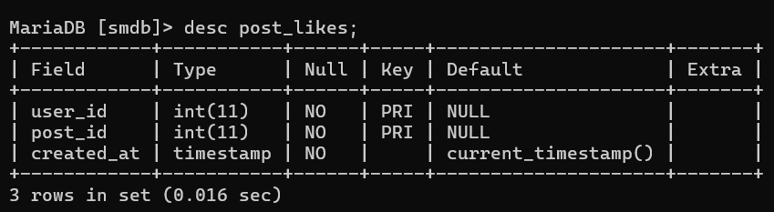
POST_LIKES
Syntax:
CREATE TABLE post_likes (
user_id INT NOT NULL,
post_id INT NOT NULL,
PRIMARY KEY (user_id, post_id),
FOREIGN KEY (user_id) REFERENCES users(user_id),
FOREIGN KEY (post_id) REFERENCES post(post_id)
);

Slide 9
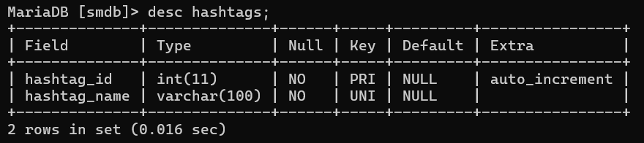
HASHTAGS
Syntax:
CREATE TABLE hashtags (
hashtag_id INT AUTO_INCREMENT PRIMARY KEY,
hashtag_name VARCHAR(100) UNIQUE NOT NULL
);

Slide 10
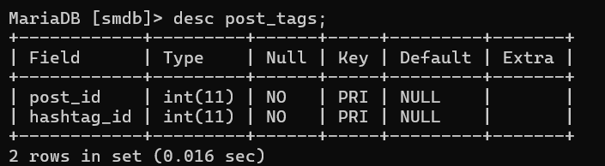
POST_TAGS
Syntax:
CREATE TABLE post_tags (
post_id INT NOT NULL,
hashtag_id INT NOT NULL,
PRIMARY KEY (post_id, hashtag_id),
FOREIGN KEY (post_id) REFERENCES post(post_id),
FOREIGN KEY (hashtag_id) REFERENCES hashtags(hashtag_id)
);

Slide 11
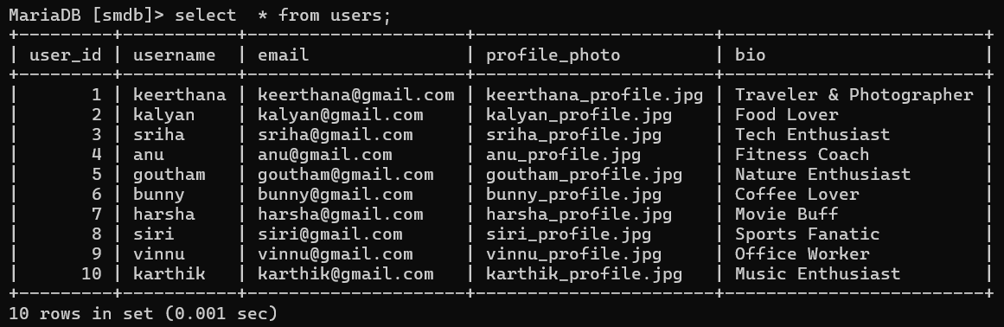
CONTENTS OF TABLE
To insert data in table
Syntax: Insert into table_name values();
To retrieve the data from table
Syntax: Select * from table_name;
USERS

Slide 12
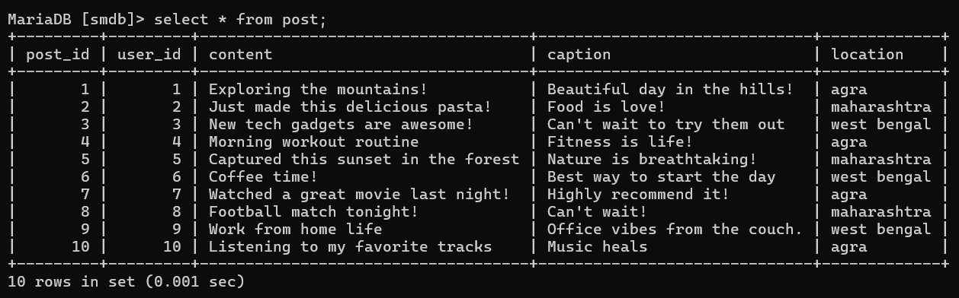
POST

Slide 13
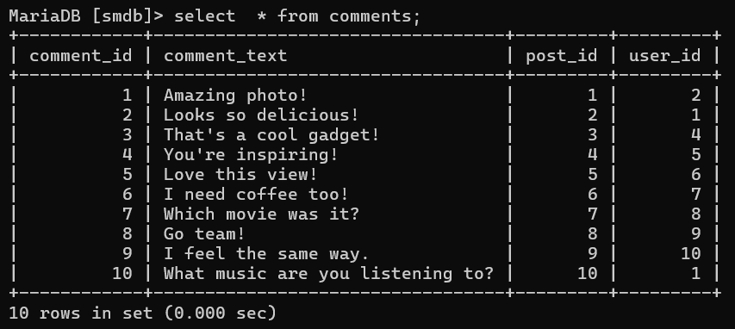
COMMENTS

Slide 14
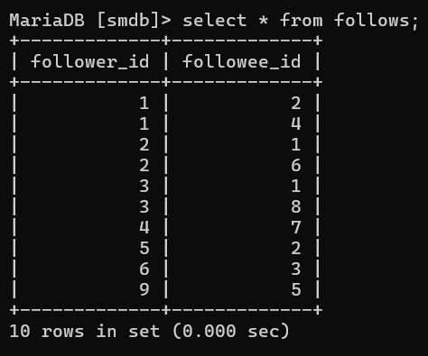
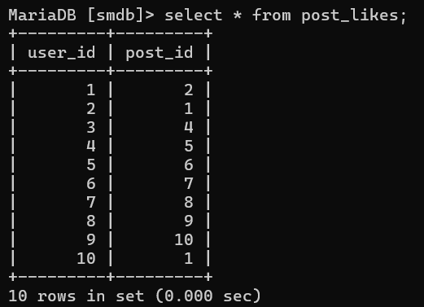
FOLLOWS
POST_LIKES

Slide 15
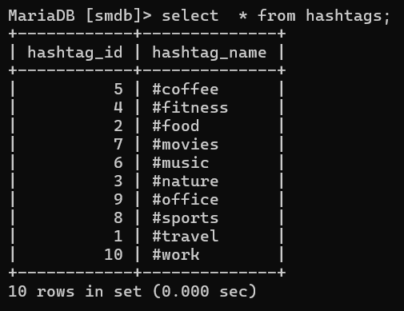
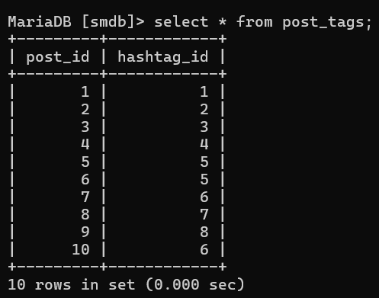
HASHTAGS
POST_TAGS

Slide 16
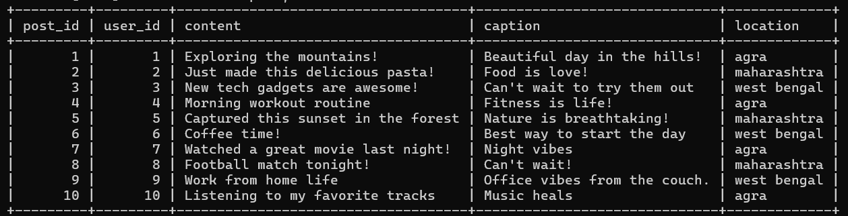
Updating caption Night vibes for a post having post_id =7
Syntax:
Update post set caption =‘Night vibes’ where post_id =7;

Slide 17
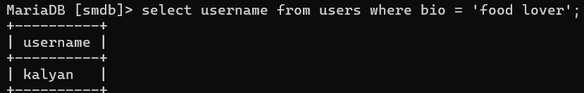
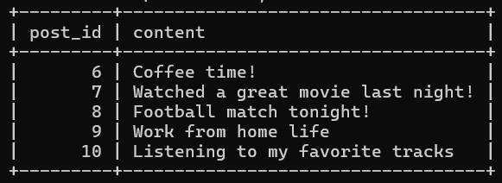
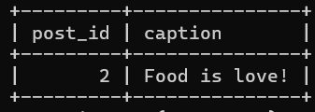
Finding username from users whose bio is food lover.
Finding post_id and content in which post_id’s greater than 5.
Syntax: SELECT post_id, content
FROM post
WHERE post_id > 5;
Finding post_id and caption where the caption contains the word "Love" .
Syntax:
SELECT post_id, caption
FROM post
WHERE caption LIKE '%Love%';

Slide 18
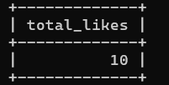
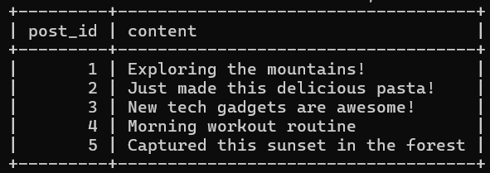
Find the total number of likes across all posts:
Syntax:
select count(*) as total_likes
from post_likes;
Finding post_id and content by using range.
Syntax:
select post_id, content, user_id
from post
where user_id between 1 and 5;

Slide 19
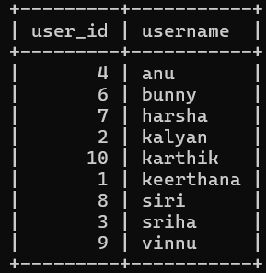
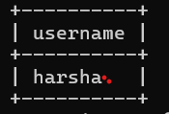
Finding users where the user_id is not equal to 5.
Syntax:
select user_id, username
from users
Where user_id != 5;
Finding users where user_id is equal to 7
select username
from users
where user_id =7;
Syntax:

Slide 20
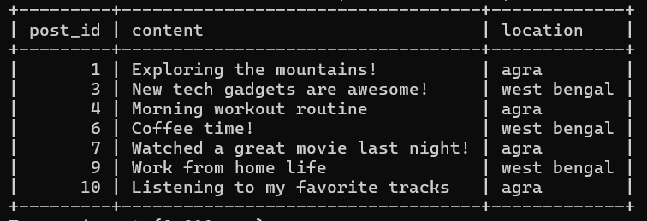
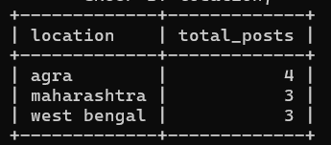
Finding post_id,content ,location from specific locations.
Syntax:
select post_id, content, location
from post
where location in ('agra', 'west bengal');
Find the total number of posts per location:
Syntax:
select location, count(post_id) as total_posts
from post
Group by location;

Slide 21
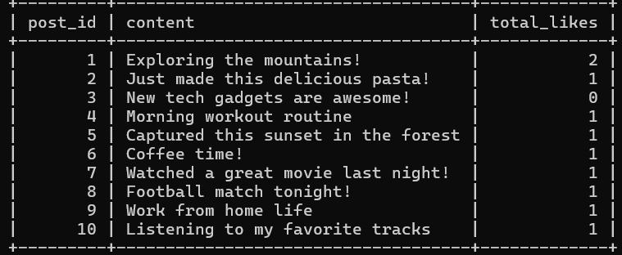
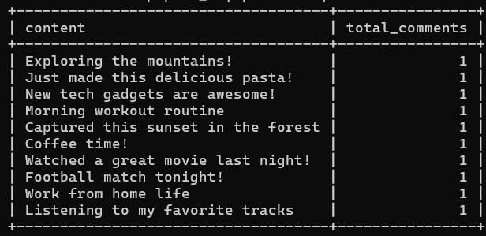
Finding Count of no. of comments on each post:
Finding posts with the number of likes per post .
Syntax:
select p.post_id, p.content, count(pl.user_id) as total_likes from post as p
left join post_likes as pl
on p.post_id = pl.post_id
group by p.post_id, p.content;
Syntax:
select p.content, count(c.comment_id) as total_comments
FROM post as p
LEFT JOIN comments as c on p.post_id = c.post_id
Group by p.post_id, p.content;

Slide 22
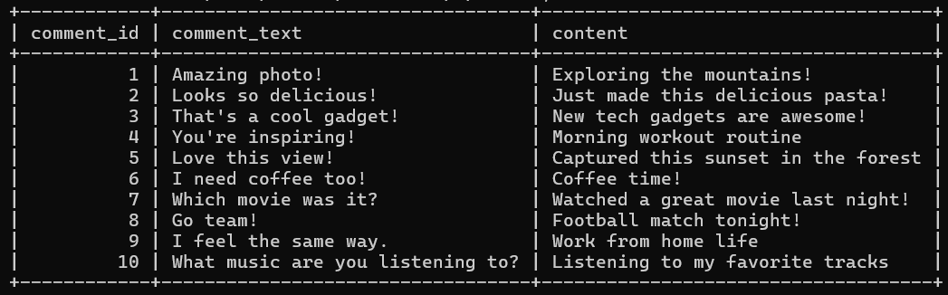
Finding all comments along with the post content for each comment.
Syntax:
select c.comment_id, c.comment_text, p.content
from comments as c
INNER JOIN post as p on c.post_id = p.post_id;

Slide 23
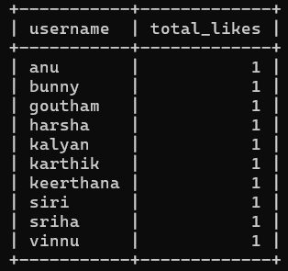
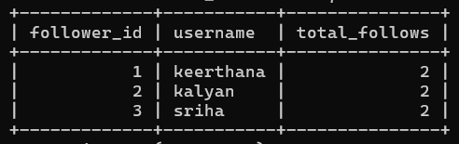
Find the total number of likes for each user:
Syntax:
select u.username, count(pl.post_id) as total_likes
from users as u
LEFT JOIN post_likes as pl on u.user_id = pl.user_id
group by u.username;
Find users who follow more than 1 person.
Syntax:
select f.follower_id, u.username, count(f.followee_id) as total_follows
from follows as f
INNER JOIN users as u on f.follower_id = u.user_id
Group by f.follower_id, u.username
HAVING total_follows > 1;

Slide 24
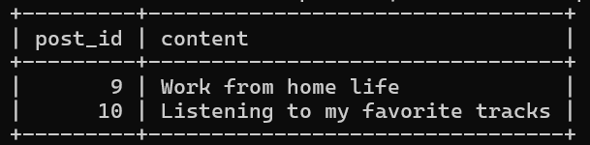
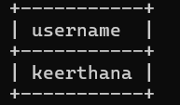
Finding list of posts made by users whose user_id is greater than user who created post_id 8.
Syntax:
Select post_id, content
from post
where user_id>
(select user_id from post where post_id =8);
Finding users with the most Comments
Syntax:
select username from users
where user_id = ( select user_id from comments
group by user_id
order by count (comment_id) desc limit 1 );

Slide 25
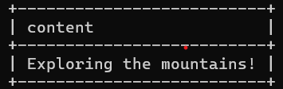
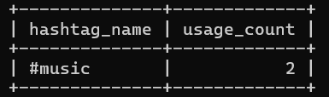
Finding Posts tagged with a hashtag travel.
Syntax:
select post.content from post
where post_id in ( select post_id from post_tags
where hashtag_id = (select hashtag_id from hashtags
where hashtag_name = '#travel’ ));
Finding the Most Used Hashtag
Syntax:
select hashtag_name, count(*) as usage_count
from hashtags join post_tags
on hashtags.hashtag_id = post_tags.hashtag_id
Group by hashtag_name
Order by usage_count DESC
limit 1;

Slide 26
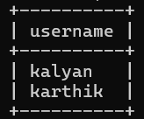
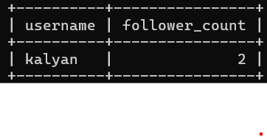
Finding users who have liked all of user_id posts.
Syntax:
select username from users
where user_id in ( select user_id from post_likes
where post_id in ( select post_id from post where user_id = 1 )
group user_id having count(post_id) = (select count(post_id) from post
where user_id = 1 ));
Finding the Most Followed User
Syntax:
Select username, count(follower_id) as follower_count
from users join follows
on users.user_id = follows.followee_id
group by username
order by follower_count desc
limit 1;

Slide 27
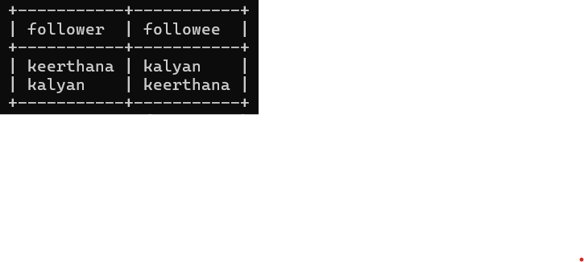
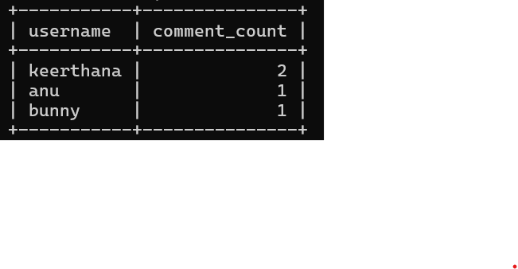
Finding users who are following each other
Syntax:
SELECT u1.username AS follower, u2.username AS followee
FROM follows f1 JOIN follows f2
ON f1.follower_id = f2.followee_id
AND f1.followee_id = f2.follower_id
JOIN users u1 ON f1.follower_id = u1.user_id
JOIN users u2 ON f1.followee_id = u2.user_id;
Finding top 3 users with the most comments
Syntax:
SELECT users.username, COUNT(comments.comment_id) AS comment_count
FROM users
JOIN comments ON users.user_id = comments.user_id
GROUP BY users.username
ORDER BY comment_count DESC
LIMIT 3;

Slide 28
THANK YOU!

